Slide 1
Design Patterns
Unit 03
Class Diagram and Object Diagram

Slide 2
Objectives
In this lesson, you will learn to:
Identify the behavior of a class
Identify the attributes of a class
Create a Class diagram
Create an Object diagram

Slide 3
The Structural View
Represents the static aspect of a system
Comprises:
  Class Diagrams
    Depict various classes and their associations
    Describes the classes that are declared within the system
  Object Diagrams
    Depict various objects and their links with each other

Slide 4
Classes
Are used for modeling the real-world entities that have common characteristics
Are of different types
  Entity classes - are the one that are examined by use case for the entities that interact with the system
  Control classes - are the one that control the working of the use case
  Boundary classes – mapping of information to relevant classes during the in flow and out flow of information

Slide 5
Classes(Contd.)
Consider the following example, the use cases in the billing system of the department store are
  Enter Bill Details
  Calculate Total Amount
  Print Bill
The use case Enter Bill Details is mapped to class called BillDetailAcceptor
The table given below shows the classes identified for the above example:

Slide 6
Use Case Diagrams
Enter Bill Details
Clerk
Calculate Total Amount
Print Bill
Clerk

Slide 7
Classes(Contd.)
Use Case
Class
Control
Entity
Boundary
Enter Bill Details
BillDetailAcceptor
Clerk
Product, Bill
Calculate Total Amount
TotalAmountCalculator
Bill
Print Bill
BillPrinter
Clerk
Bill

Slide 8
Identify Behaviors
The behavior is the action performed by a class
The table given below shows the behavior identified for the billing system example

Slide 9
Identify Behaviors(Contd.)
Class
Behavior
BillDetailAcceptor
ValidateBillDetail()
Clerk
EnterBillDetail()
Product
TotalAmountCalculator
calculateTotalAmount()
BillPrinter
printBill()
Bill
addProductDetail(), editProductDetail(), deleteProductDetail().

Slide 10
Identify Attribute
Attributes are the characteristics of the class
The table given below shows the attributes identified for the billing system example

Slide 11
Identify Attribute(Contd.)
Class
Attribute
BillDetailAcceptor
Clerk
clerkCode and clerkName
Product
ProductCode, productName, and unitPrice
TotalAmountCalculator
BillPrinter
Bill
billNo, product and quantityBought

Slide 12
Diagrammatic conventions for Drawing
Class Diagrams
Multiplicity indicators are used to represent the relationship between different classes
Representation
Multiplicity
1
represents exactly one
0..*
represents zero or more
1..*
represents one or more
0..1
represents zero or one
1..5
represents specified
range

Slide 13
Relationship Between Classes
There can be different kind of relationship between different classes
Given below are the kind of relationship that exist between different classes in the billing system example
  One-to-One relationship exists between the class clerk and the class BillDetailAcceptor
  One-to-One relationship exists between the class BillDetailAcceptor and the class Bill
  One-to-Many kind of relationship exists between the class Bill and the class Product

Slide 14
Class Diagram
Given below is the representation of the class diagram
<Class Name>
<Class Attributes>
<Class Behavior>

Slide 15
Class Diagram(Contd.)
Clerk
clerkCode
clerkName
enterBillDetail()
BillDetailAcceptor
validateBillDetail()
Bill
billNo
product
quantityBought
addProductDetail()
editProductDetail()
deleteProductDetail()
1 1
1 1
1
1..*
Product
productCode
productName
unitPrice

Slide 16
Problem Statement
In the internal job postings process, the HR head of the region where the vacancy exists informs the employees of that region and other regional HR heads about the vacancy. The other regional HR heads inform employees by putting up a notice with the vacancy information.
Identify the classes, their attributes and behaviors, and draw the class diagram.

Slide 17
Use Case Diagrams
Distribute Information
RHR (O)
RHR (V)
EMP

Slide 18
Identify Classes
Classes
Control
Entity
Boundary
Distribution Manager
Regional HR Head (V)
Position Vacant
Regional HR Head (O)
Employee

Slide 19
Identify Behaviors
Class
Behavior
Distribution Manager
- informRegions()
- notifyEmployees()
Position Vacant
Regional HR Head (V)
- enterVacancyDetails()
Regional HR Head (O)
Employee

Slide 20
Identify Attributes
Class
Attribute
Distribution Manager
Position Vacant
- regionName
- noOfVacancy
- skillsRequired
Regional HR Head (V)
- regionName
Regional HR Head (O)
- regionName
Employee
- empCode
- empName
- qualification
- dateOfJoining
- yearsOfExperience

Slide 21
Solution
Position Vacant
regionName
noOfVacancy
skillRequired
Regional HR Head (V)
regionName
enterVacancy
Details()
Distribution Manager
informRegions()
notifyEmployees()
Regional HR
Head (O)
regionName
1..* 1
1 1
1 1..*
1
Employee
empCode
empName
qualification
dateOfJoining
yearsOfExperience
1..*

Slide 22
Problem Statement(Personal)
In response to the vacancy information, employees from various regions send their applications to the HR head of the region where the vacancy exists.
Identify the classes, their attributes and behaviors, and draw the class diagram.

Slide 23
Use Case Diagrams
Send Application
EMP
RHR (V)

Slide 24
Answer (Personal)
Employee and Application Manager is One-to-Many Relationship
Application Manager and Regional HR Head (V) is One-to-One Relationship
Employee and Application is One-to-One Relationship

Slide 25
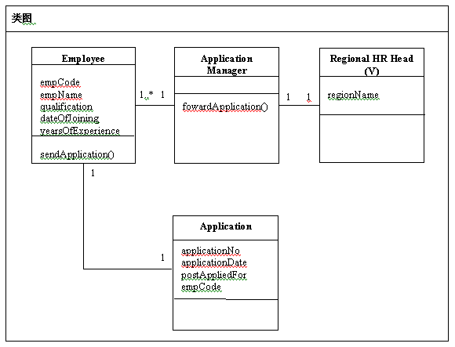
Answer (Personal)

Slide 26
Object Diagrams
Describe the static structure of a system at a particular instance in time
Describe the instantiation of a class diagram
Contain objects and links
Cover instances of the classes found in the class diagram

Slide 27
Object Diagrams(Contd.)
In the billing system example, a customer Michael White wants to buy Ashton Television. He selects the television and comes to the billing counter. The clerk Robert Clark enters the item details. The system then calculates the total amount and prints the bill.

Slide 28
Identify Object
An object is an instance of a class and demonstrates attributes and behaviors of the class
The table given below shows the object identified for the billing system example

Slide 29
Identify Object(Contd.)
Class
Object
BillDetailAcceptor
Clerk
Robert Clark
Product
Ashton Television
TotalAmountCalculator
BillPrinter
Bill

Slide 30
Identify Object(Contd.)
Given below is the representation of the object diagram
<Class Name >: <Object Name>
< Object Attributes>
< Object Behavior>

Slide 31
Identify Object(Contd.)
Clerk:
Robert Clark
clerkCode
clerkName: Robert Clark
enterBillDetail()
BillDetailAcceptor
validateBillDetail()
Bill
billNo
product: Ashton Television
quantityBought: 1
addProductDetail()
editProductDetail()
deleteProductDetail()
Product:
Ashton Television
productCode
productName: Ashton Television
unitPrice

Slide 32
Problem Statement
In the internal job postings process, the HR head of the Springfield region where the vacancy exists informs the employees of that region and other regional HR heads. According to him, a vacancy for the post of Store incharge exists in the company. The qualification required is at least 2 years of experience for managing the stores. The other regional HR heads inform their employees by putting up a notice with the vacancy information.
Draw the object diagram.

Slide 33
Solution
Position Vacant
RegionName: Springfield
NoOfVacancy: 1
SkillRequired: 2years Exp
Regional HR Head (V)
RegionName:Springfield
enterVacancy
Details()
Distribution Manager
informRegions()
notifyEmployees()
Regional HR
Head (O)
regionName
Employee
empCode
empName
Qualification
DateOfJoining
YearsOfExperience

Slide 34
Problem Statement(Personal)
In response to the vacancy information as discussed above. Employees from various regions send their applications to the HR head of the region where the vacancy exists.
Jerry who has the required qualifications is interested in the post. He provides the following details to the HR department:

Slide 35
Problem Statement(Contd.)
EmpCode
E00112
EmpName
Jerry Black
DateOfJoining
11/10/1999
YearsOfExperience
2

Slide 36
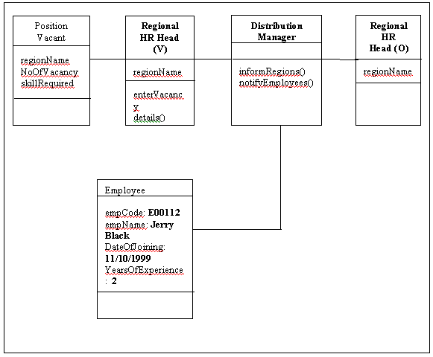
Answer (Personal)

Slide 37
Summary
In this lesson you learned:
The structural view represents the static aspect of a system, and comprises class and object diagrams.
Class diagrams depict various classes and their associations.
An object diagram describes the static structure of a system at a certain point in time.
An object diagram describes the instantiation of a class diagram.

